Slide 1
Plugin
Dynamically expand the application

Slide 2
Purpose of plugins
Adding new ability to already compiled application
Benefit?
Easier upgrade
Easier maintenance (isolation)

Slide 3
Task list
Prepare the contract (interface)
Implement the plugins
Load and use

Slide 4
Quick Start

Slide 5
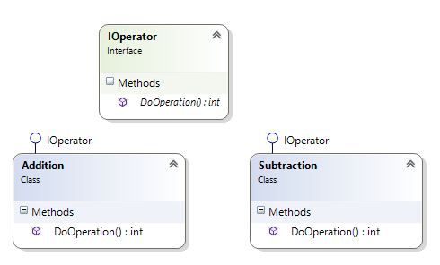

Example result
Contract
Two implemented dll modules

Slide 6
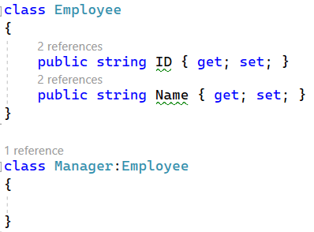
Create an instance of a class

Slide 7
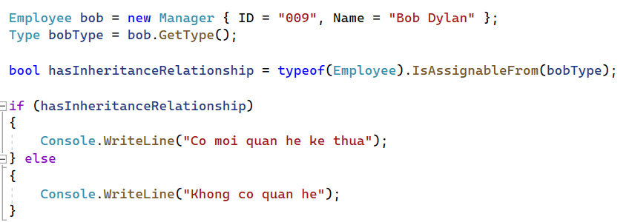
Check if a class inherits from another class

Slide 8
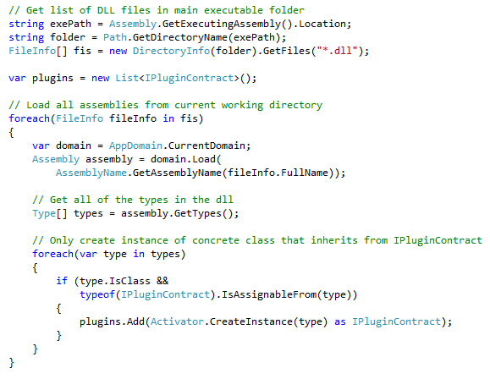
How to load dll plugins

Slide 9
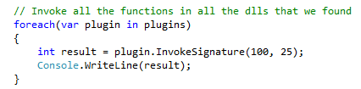

Execute the DLLs

Slide 10
Improvement
Add two more operation: Multiplication, Division
Build into dlls, copy these two new dlls into the exe and see the program has new abilities

